Slide 1
Professional audio devices designed for broadcast and theaters

Slide 2
Audio Resolution is a European company specializing in the production of professional audio devices designed for broadcast and theaters.
Drawing upon our extensive experience in system integration of AV technologies, we have produced distinctive devices tailored for our projects and clients.
Today, we proudly extend the availability of these unique solutions to a global audience.
Bohumil Tonkovic / CEO

Slide 3
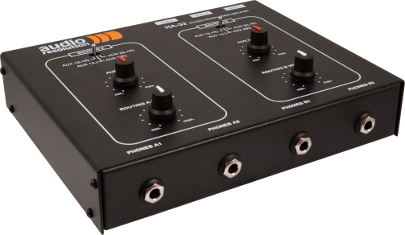
HA-32
3 balanced XLR inputs
4 (2+2) headphone outputs
2 output groups
Input routing switch to each output
3 routing possibilities (AUX1, AUX2, AUX1+2 stereo)
Separate AUX3 mix volume
VCA volume control (Voltage controlled amplifier)
High power independent to headpone impedance
Heavy duty metal case
Can be mounted on microphone stand with optional adaptor ( Yamaha BMS10A )
Portable, 2 individual stereo headphone amplifier

Slide 4
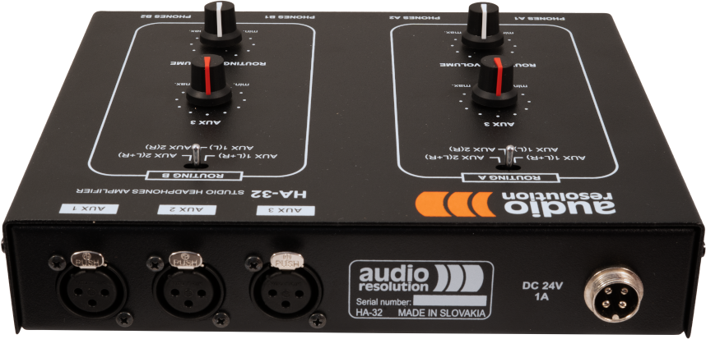
HA-32
3 balanced XLR inputs
^{www.audioresolution.com}

Slide 5
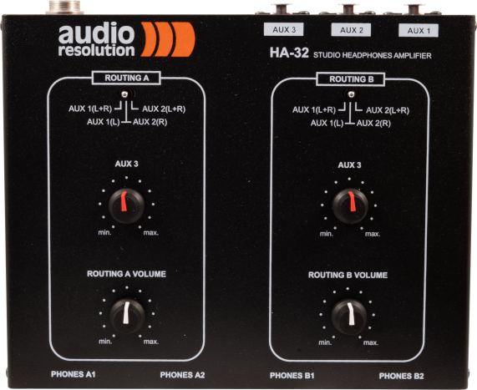
HA-32
Routing A and Routing B switching
^{www.audioresolution.com}

Slide 6
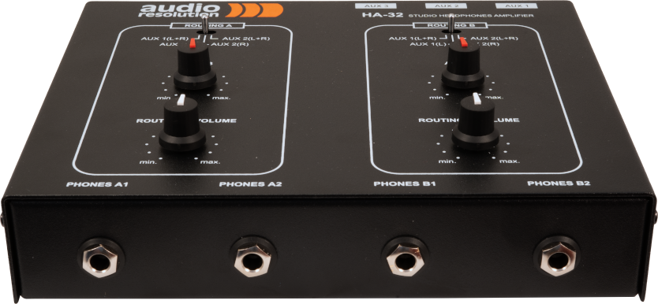
HA-32
4 (2+2) headphone outputs
^{www.audioresolution.com}

Slide 7
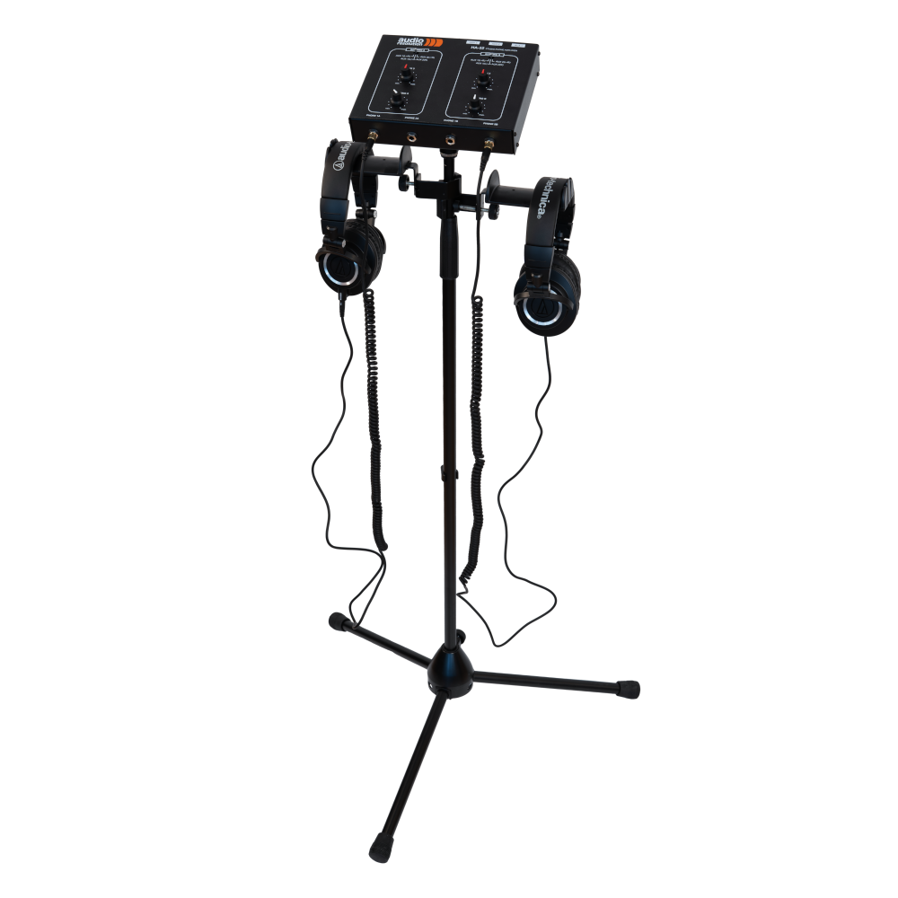
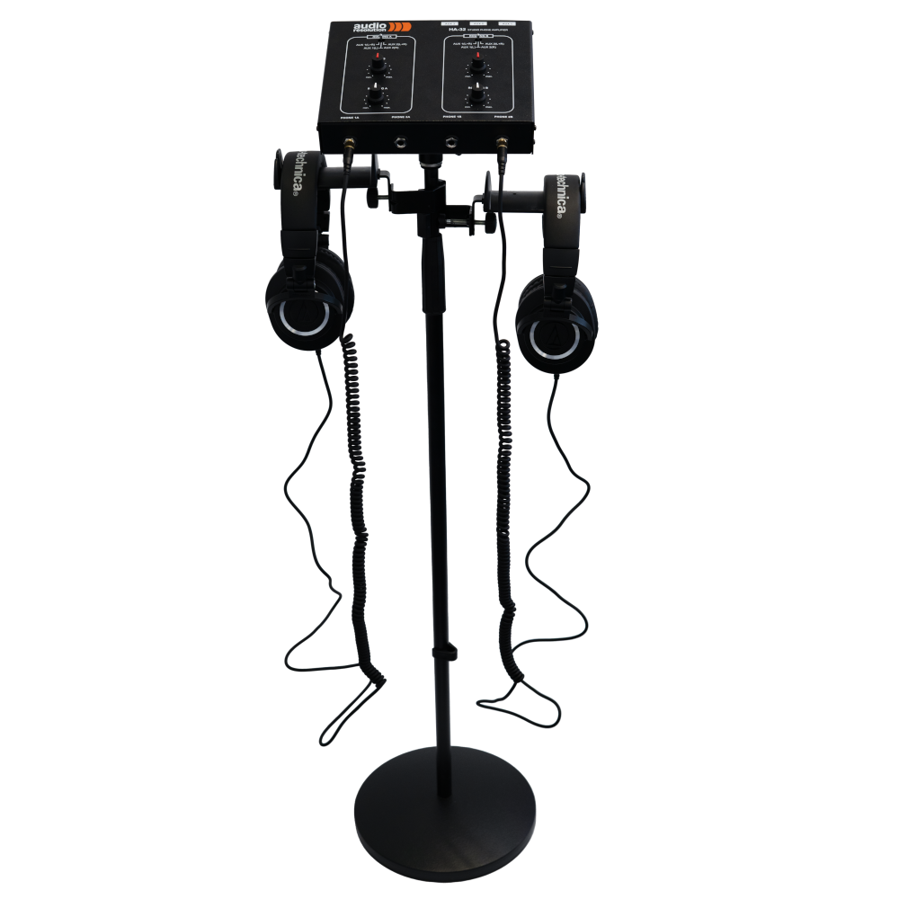
HA-32
Portable microphone stand ( Yamaha BMS10A )
^{www.audioresolution.com}

Slide 8
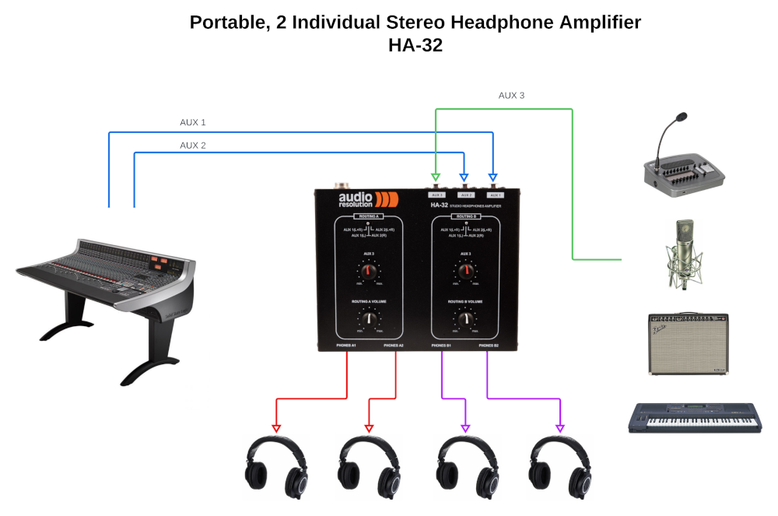
HA-32
Application scheme
^{www.audioresolution.com}

Slide 9
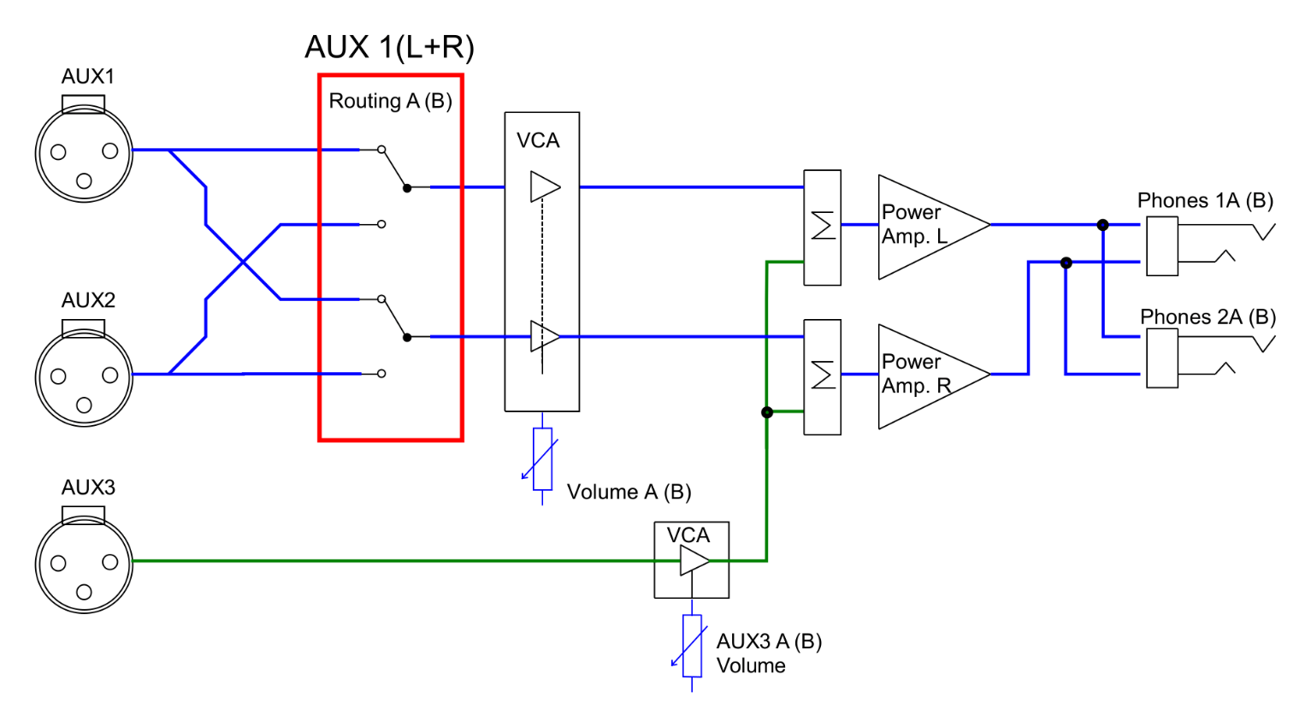
HA-32
Block diagram
^{www.audioresolution.com}

Slide 10
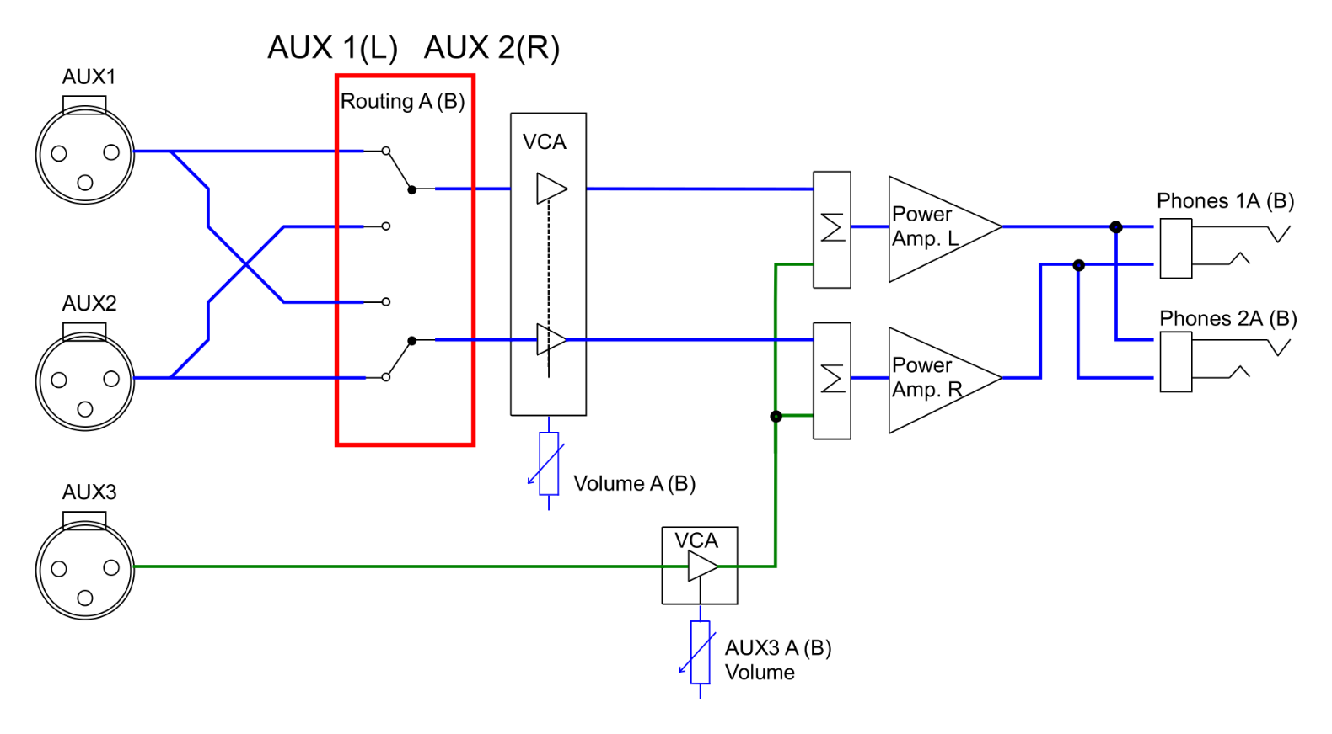
HA-32
Block diagram
^{www.audioresolution.com}

Slide 11
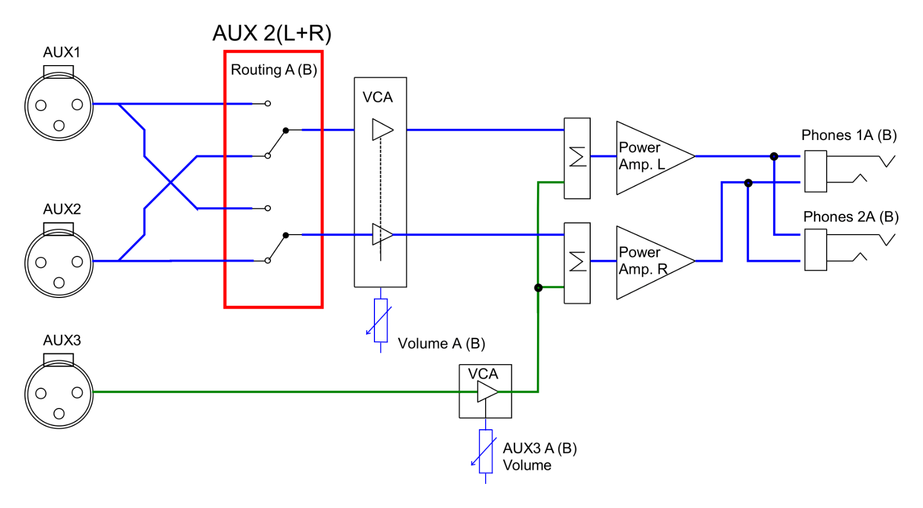
HA-32
Block diagram
^{www.audioresolution.com}

Slide 12
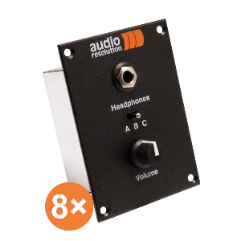
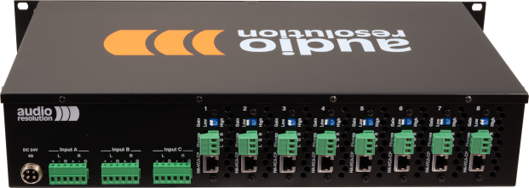
HA-8
3 stereo balanced inputs
8 independent headphone outputs
Local/ remote headphone output
VCA volume control (Voltage controlled amplifier)
Wide regulation range
Input selection routing switch
High power independent to headpone impedance
High-Fidelity, High-Performance audio amplifier
High output power
Rack mountable – 2RU
Can be downscaled to four stereo headphones channels
includes 8 remote headphone volume control units
Modular, 8 stereo channel studio headphone amplifier

Slide 13
HA-8
Headphone Inputs & Outputs
^{www.audioresolution.com}

Slide 14
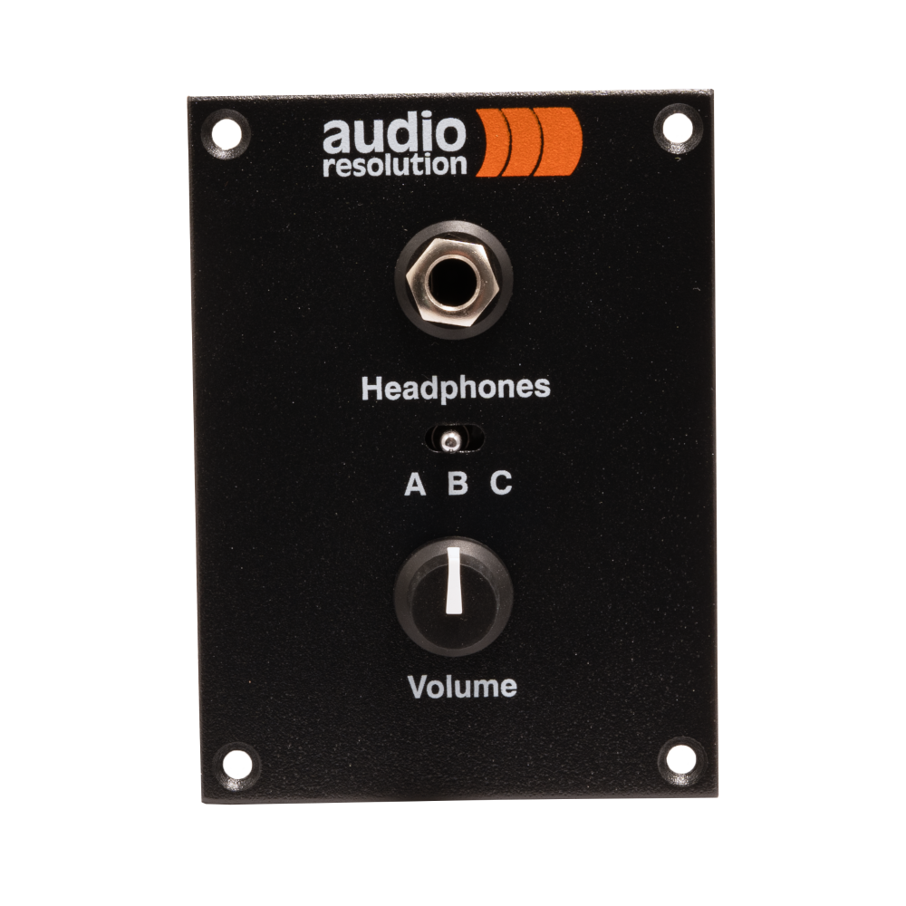
HA-8
Remote headphone output
^{www.audioresolution.com}

Slide 15
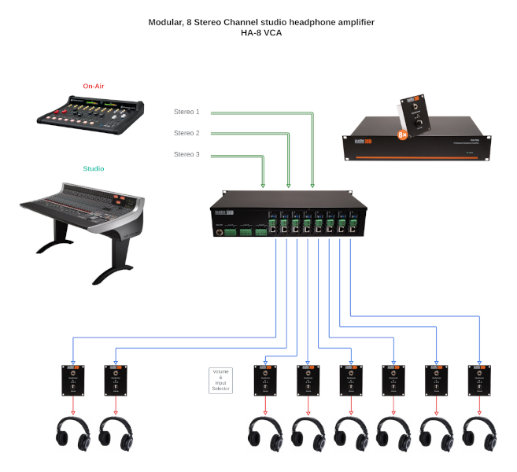
HA-8
Application scheme
^{www.audioresolution.com}

Slide 16
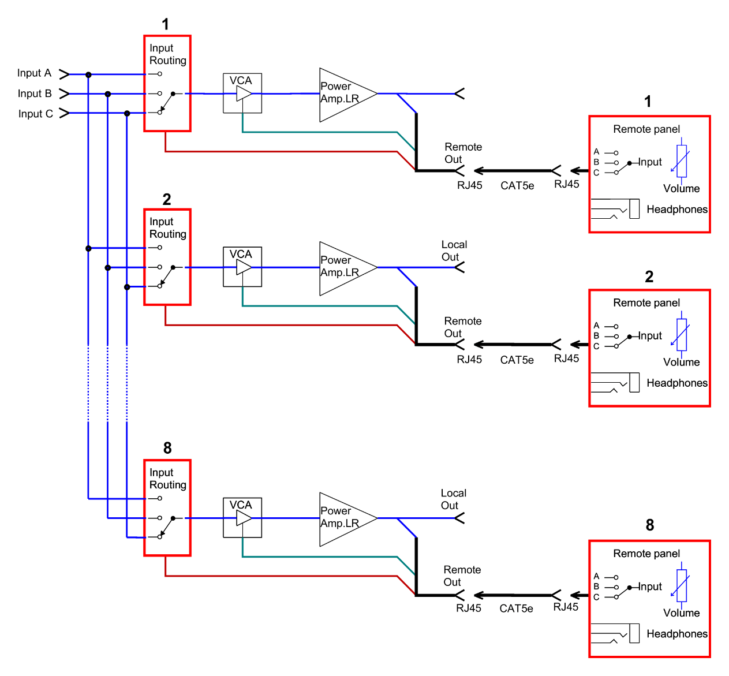
HA-8
Block diagram
^{www.audioresolution.com}

Slide 17
LC-1
2 talkback mic/line inputs
Adjustable gain and phantom power for talkback inputs
Separate talkback audio output
Isolated Red Light GPI input
Talkback GPI outputs
Separate enable switches for talkback and playback blocking on RED light
GPIO indication LEDs
Simple CAT5e cabling for talkback microphone remote control panels
Studio monitor control unit with talkback and GPIO logic

Slide 18
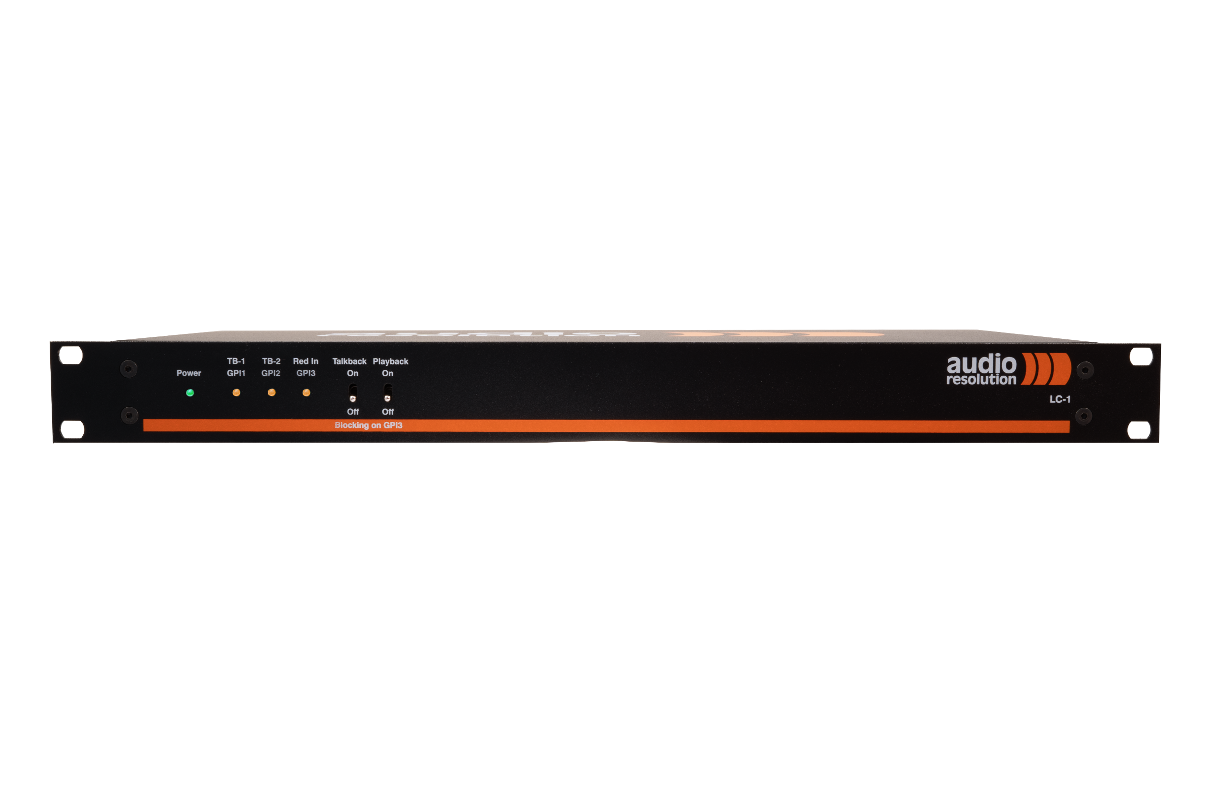
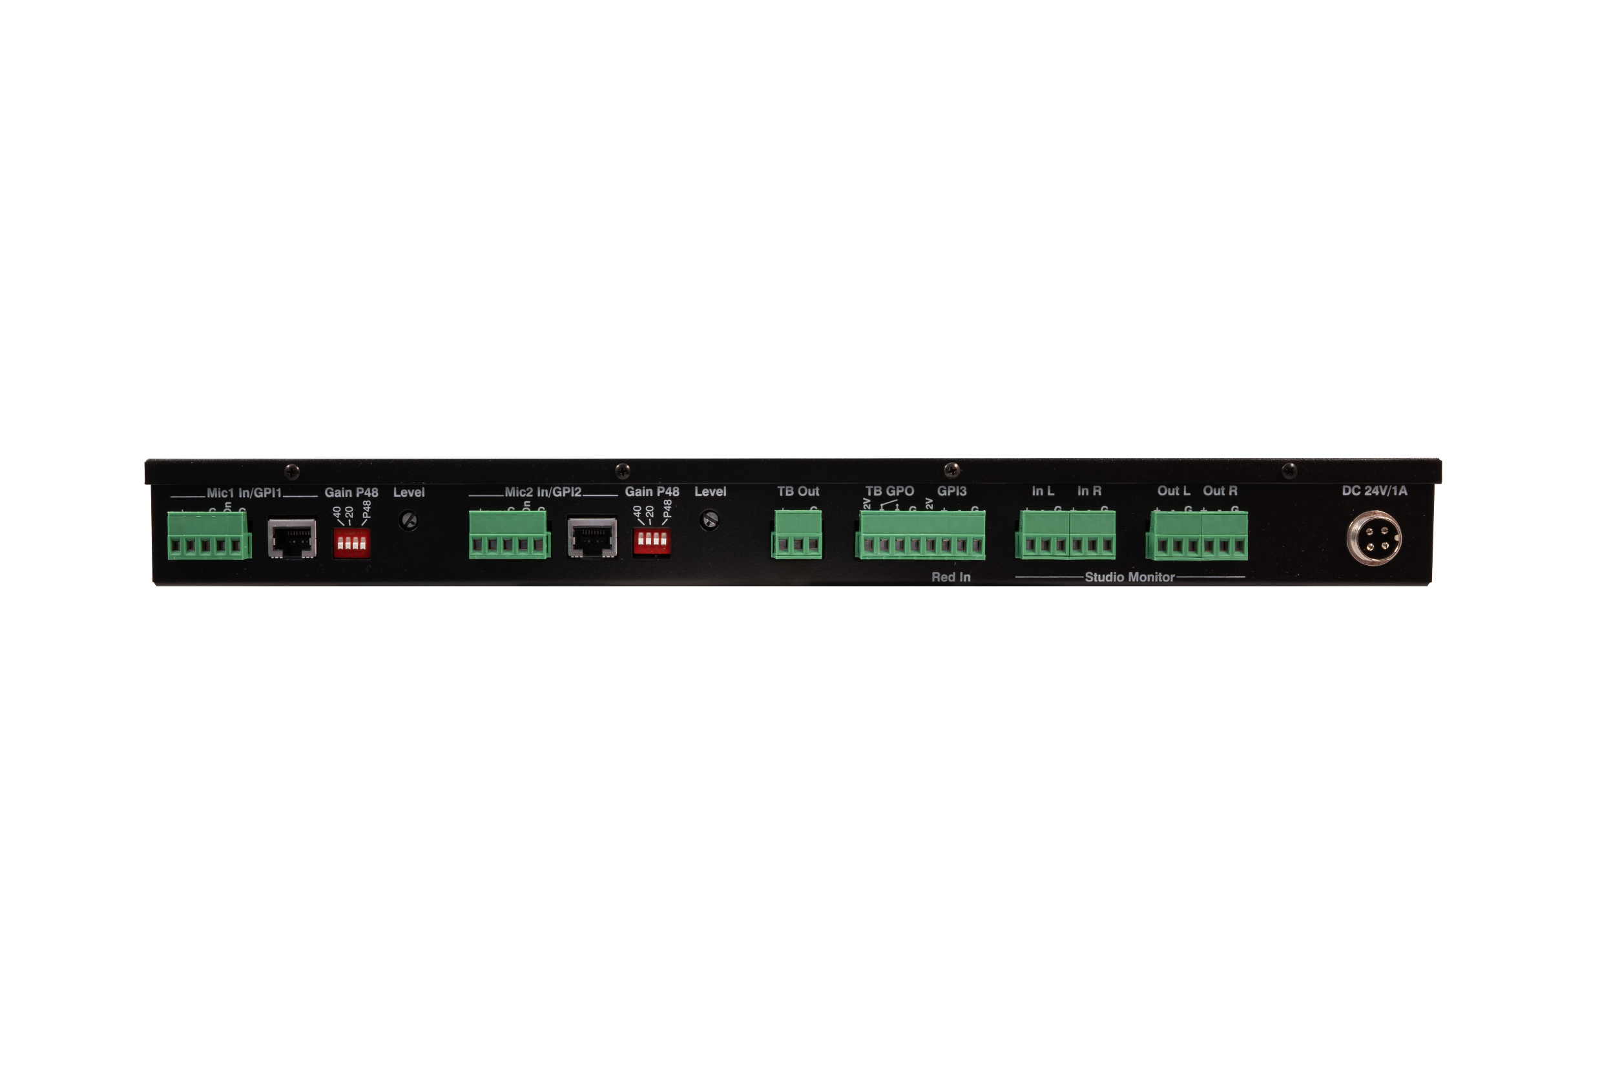
LC-1
2 talkback Mic/Line inputs
Line In & Line out to Studio Monitors
GPIO3 for RED light
^{www.audioresolution.com}

Slide 19
LC-1
Application scheme
^{www.audioresolution.com}

Slide 20
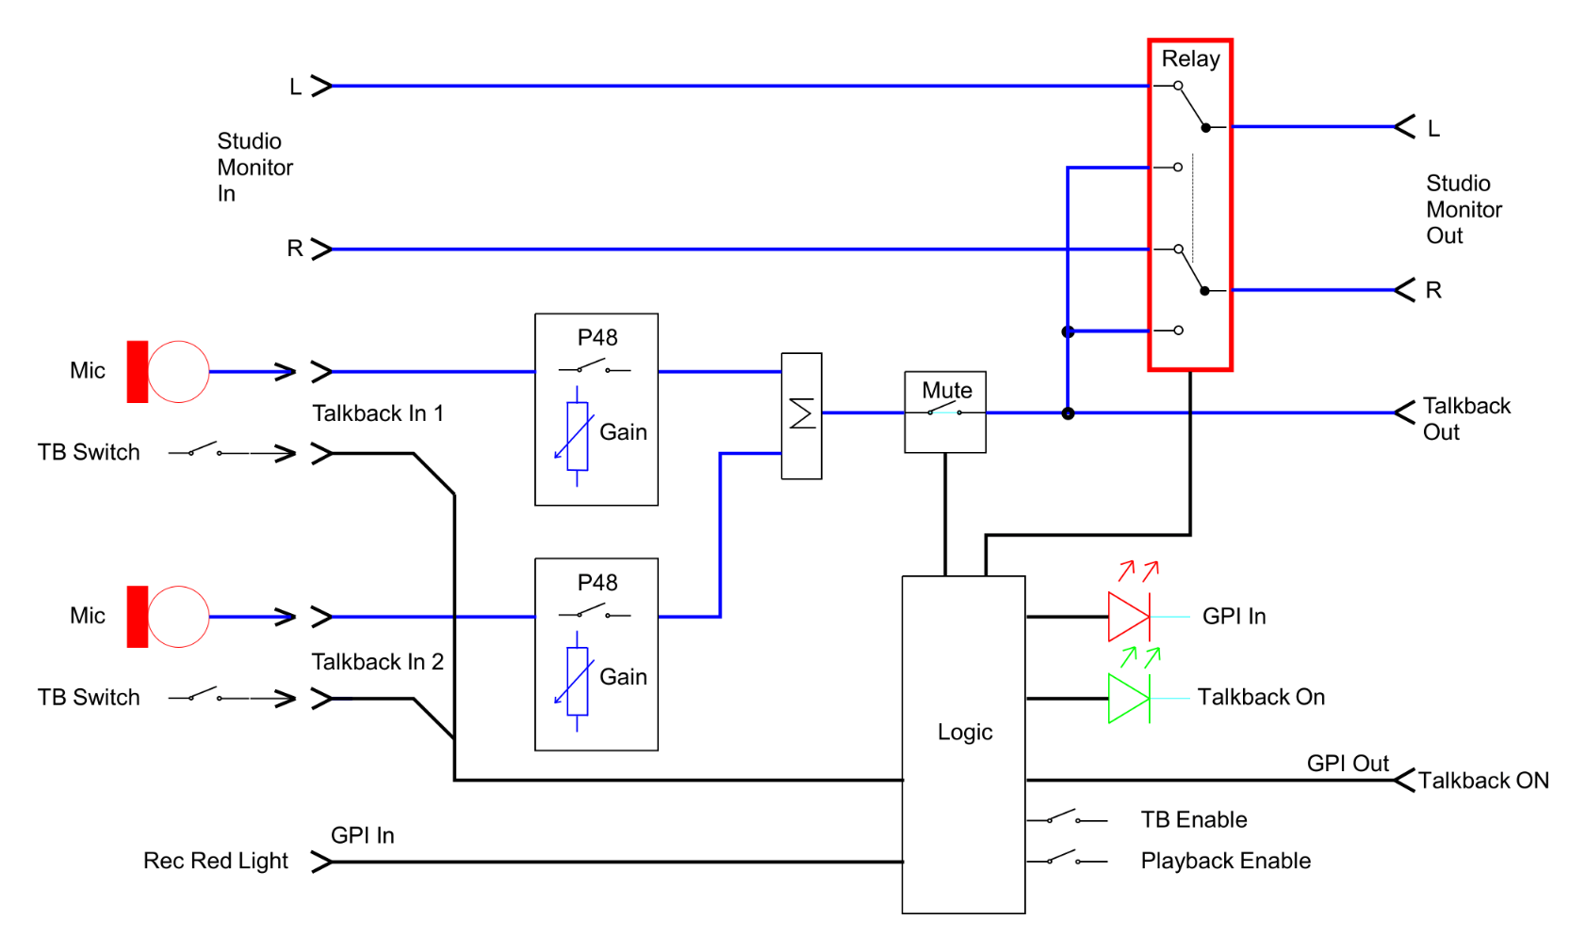
LC-1
Block diagram
^{www.audioresolution.com}

Slide 21
AFP-16
16 playback buttons with LED playback indication
Transformer balanced audio output
Isolated GPI inputs and output
Announcement master volume control
Announcement playback blocking signalization
Built in control speaker with volume control
Professional instant messaging audio player
^{www.audioresolution.com}

Slide 22
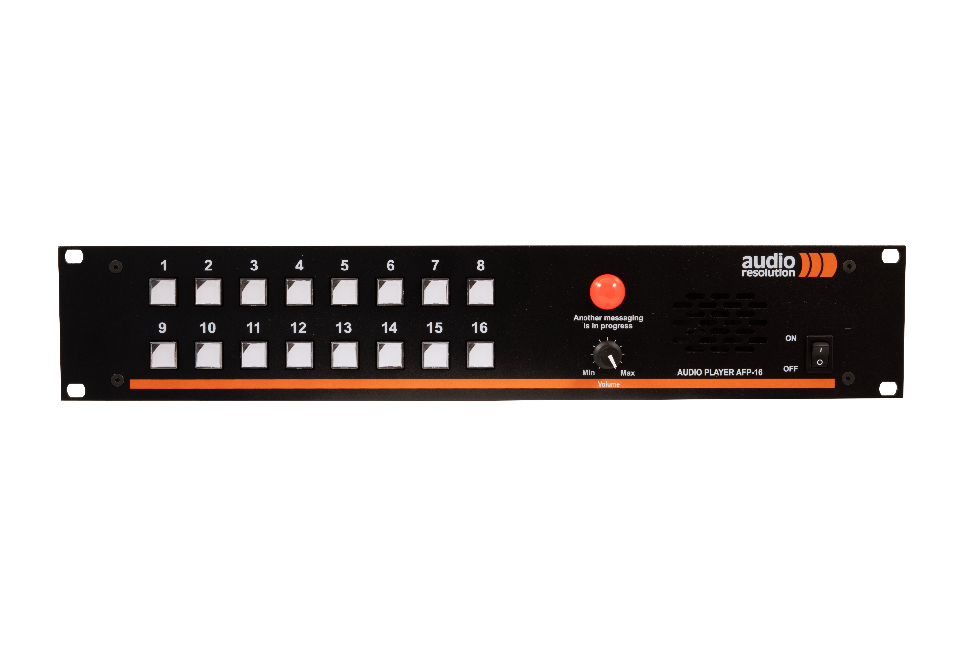
AFP-16
AFP-16 backside
^{www.audioresolution.com}

Slide 23
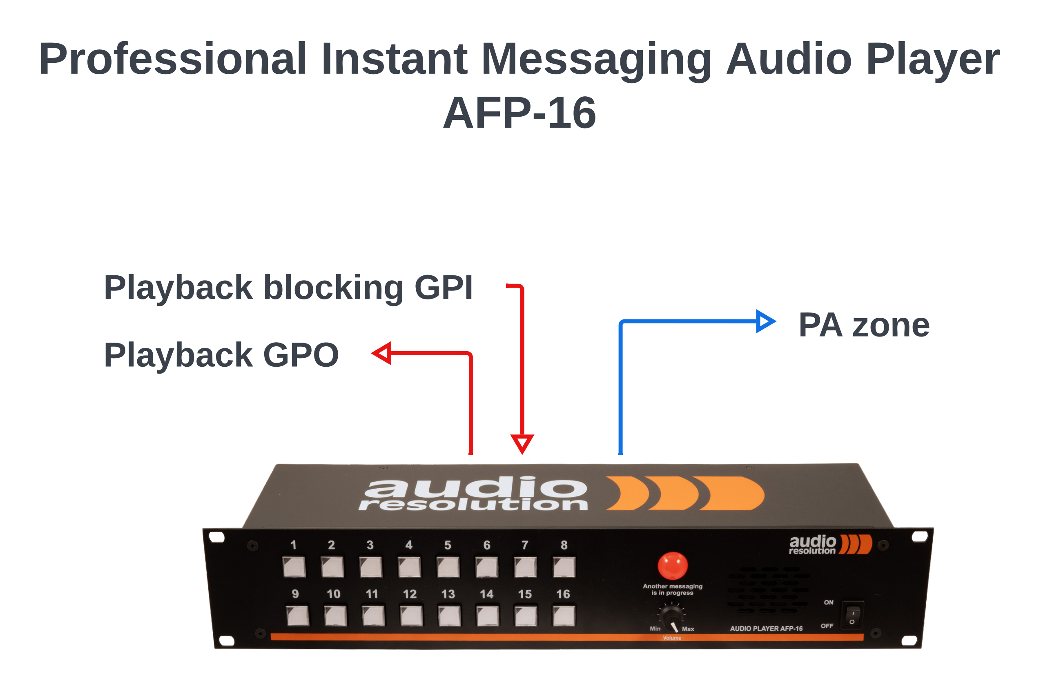
AFP-16
Application scheme
^{www.audioresolution.com}

Slide 24
Thank you for your attention
www.audioresolution.com
sales@audioresolution.com

